Slide 1


Attacks,Mitigation & Application to Business By Team Vulnerable Geeks
Azhar Ali
Aryan Singh Quantum School of Technology
Anamol Kumar Second Year

Slide 2

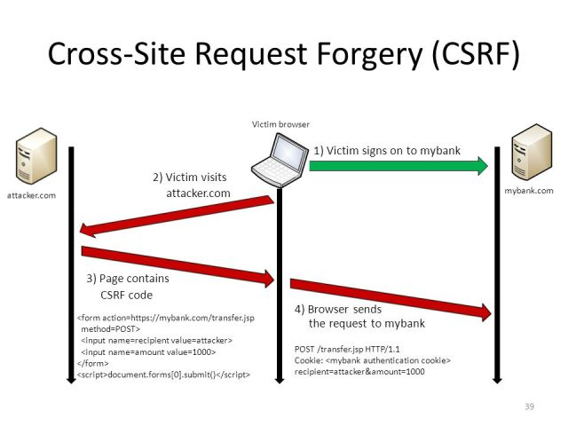
Problem Statement (Introduction)
Cross-Site Request Forgery (CSRF) is an attack that forces an end user to execute unwanted actions on a web application in which they're currently authenticated.
CSRF attacks specifically target state-changing requests, not theft of data, since the attacker has no way to see the response to the forged request.
CSRF is done with a little help of social engineering (such as sending a link via email or chat), an attacker may trick the users of a web application into executing actions of the attacker's choosing.
If the victim is a normal user, a successful CSRF attack can force the user to perform state changing requests like transferring funds, changing their email address, and so forth.

Slide 3
Hack Demo
For CSRF to be executed a website has to be vulnerable to this attack, sending the requests by the GET method.
This attack takes advantage of the fact that neither the browser nor the web-server verifies whether the request submitted is from authenticated user or man in the middle.
Profiling of the victim will be done using various social media platforms, learning about the likes and dislikes of the victims(OSINT).
The attacker will use social engineering to entice the end user into clicking over a forged link to buy something.
This forged link will be used to transfer the funds to the attacker. This is how we will demonstrate CSRF attack.
We can prevent CSRF attacks by using 2 factor authentication to use re-CAPTCHA and re-verify the authenticity of the user.
After verifying the re-Captcha a dynamic date and time will be generated along with the session id, which will verify the authenticated session id which was generated by the authenticated user only not by the attackers.

Slide 4
Live Demo Being shown on Projector

Slide 5
Our Solution
The solution which we developed to prevent CSRF attack is
Re-CAPTCHA
reCAPTCHA is a free service that protects our site from spam and abuse.
It uses advanced risk analysis techniques to tell humans and bots apart.
With the new API, a significant number of our valid human users will pass the reCAPTCHA challenge without having to solve a CAPTCHA, reCAPTCHA comes in the form of a widget that we can easily add to our site pages to prevent CSRF attack.

Slide 6
As the re-CAPTCHA generates a unique response on every verification, therefore the attacker can’t use that get response for CSRF attack. A live demo is being shown here on the projector.

Slide 7
SECURITY ASPECT
In new Start-ups, the developer team as well as designers are mainly focusing on the product to be delivered to the customers and they don’t go through the technical aspect of the payment, how it is happened,and which payment Gate way is being used for the transaction .
As most of the Payment Gate way are vulnerable and can be easily hacked.
Due to Vulnerability of the Web application the security expectation of the web application decreases and the CSRF attack can be done easily.
So Using the re-CAPTCHA in the web application we can prevent the CSRF attack easily.

Slide 8
Thank You

